Slide 1
Laptop Price Analysis &
Prediction Python Project
AJAY .P
19/09/2025

Slide 2
Introduction
Project Objective: To conduct a comprehensive analysis of the
laptop dataset .The goal is to provide insights that are useful for both
consumers and manufacturers.

Slide 3
Data Understanding
Dataset Source: The analysis is based on the laptopData.csv file.
Dataset Overview: The dataset contains 1303 entries with 12 attributes.
Key Attributes: Company, TypeName, Inches, Screen Resolution , CPU , Ram, Memory ,GPU, Op Sys, Weight , Price.

Slide 4
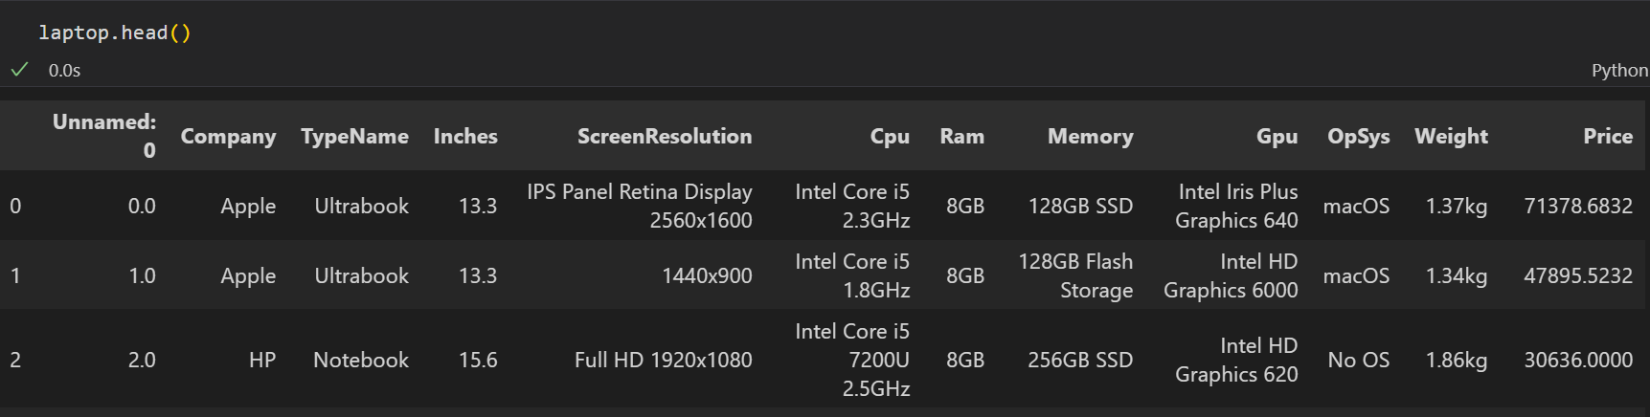
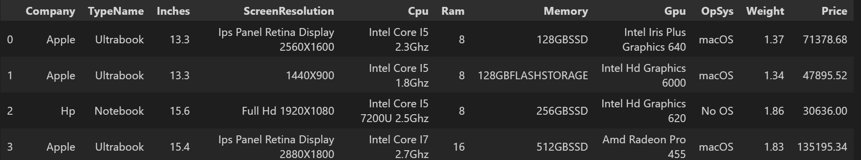
Data Cleaning
Before :-
After :-

Slide 5
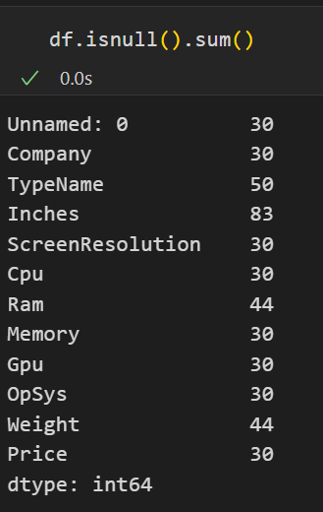
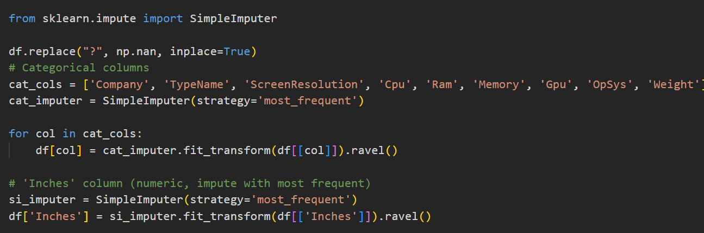
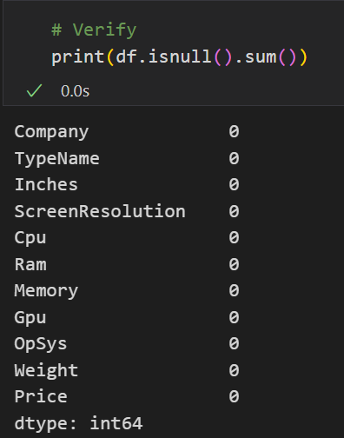
Handling Missing Values
Before :-
Replacing With Mode :-
After:-

Slide 6
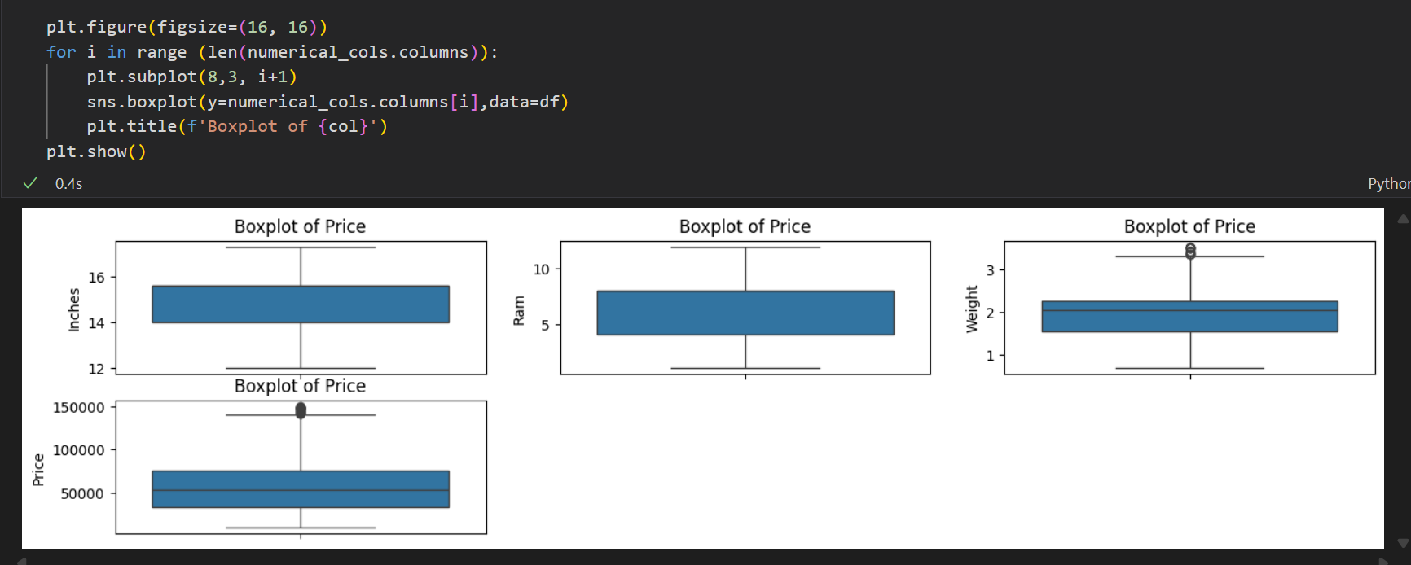
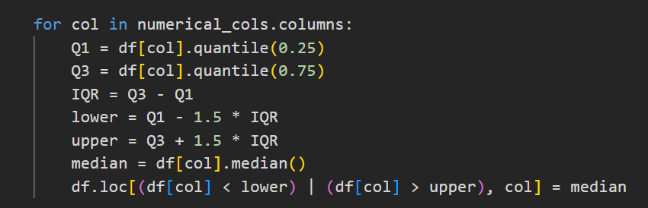
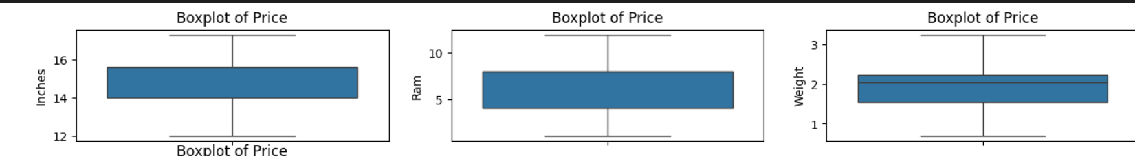
Outlier Handling
Outliers Find :-
IQR Method Replace Outliers :-
After:-

Slide 7
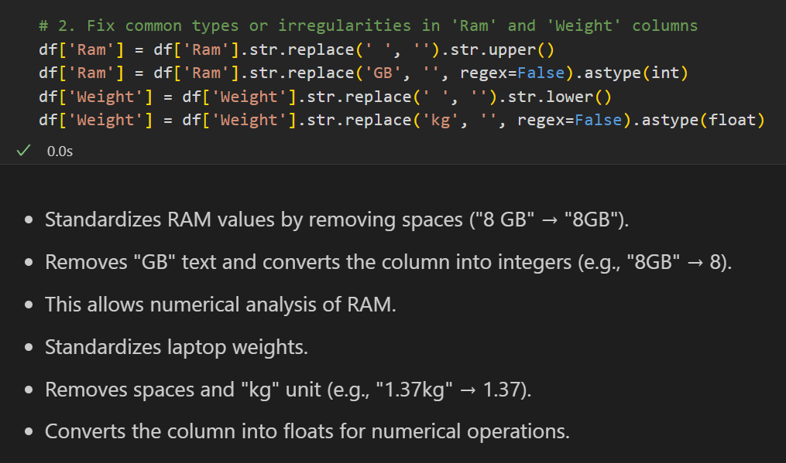
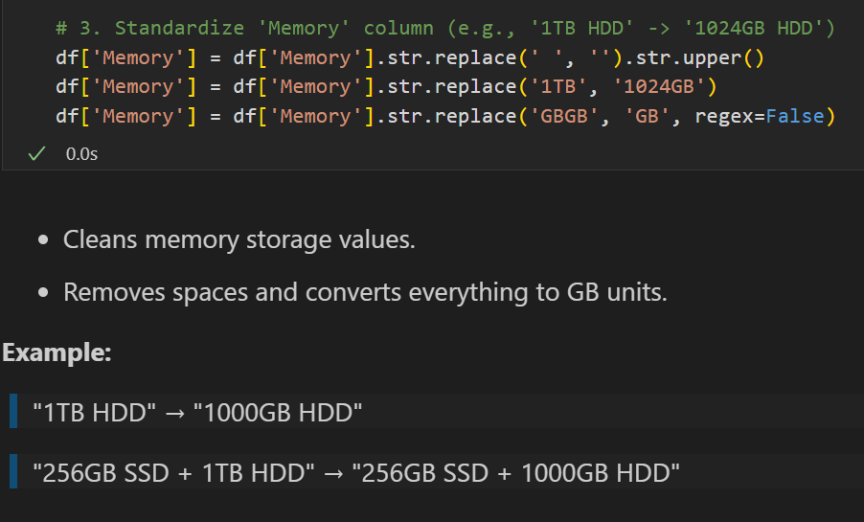
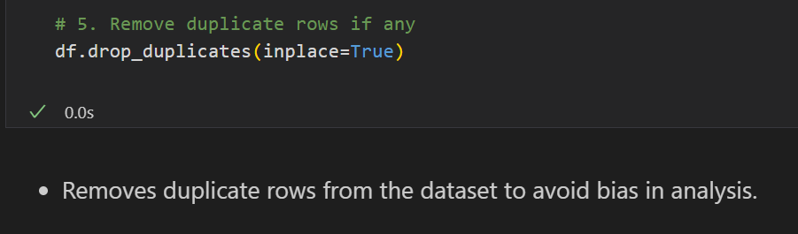
Handling Invalid Values
Data Standardization:

Slide 8
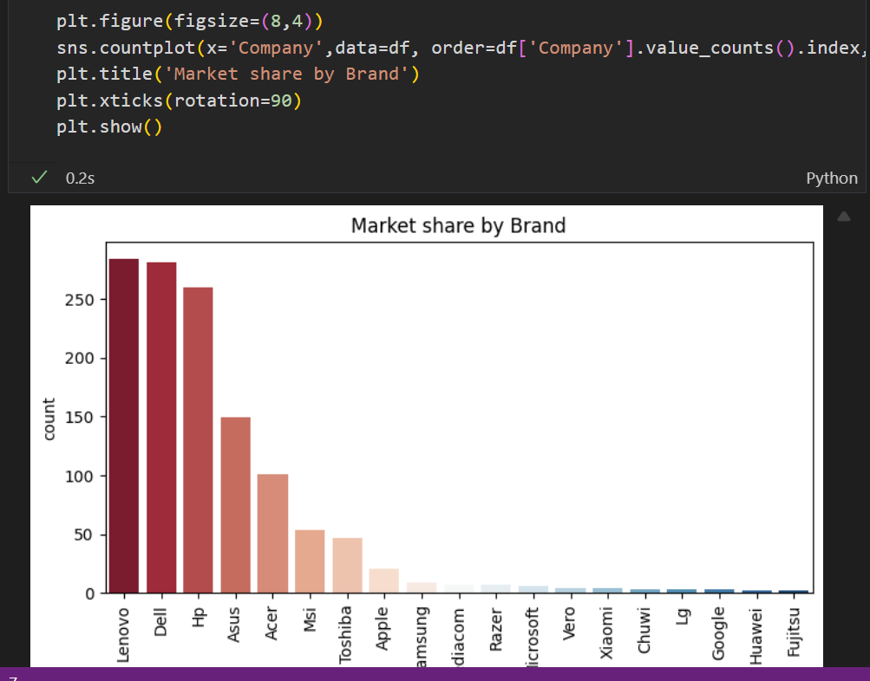
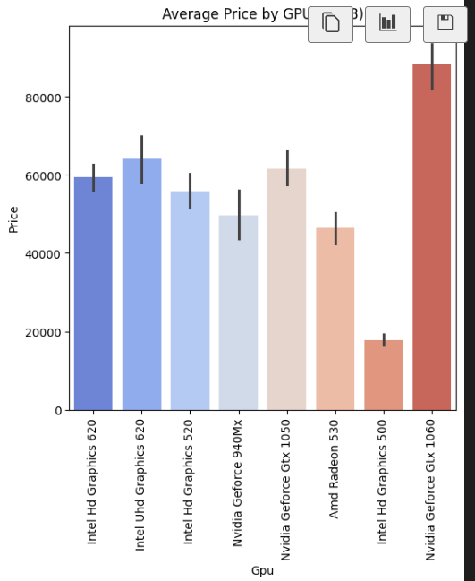
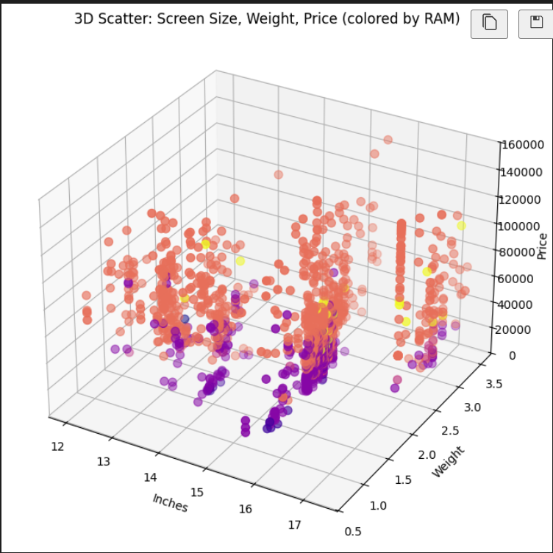
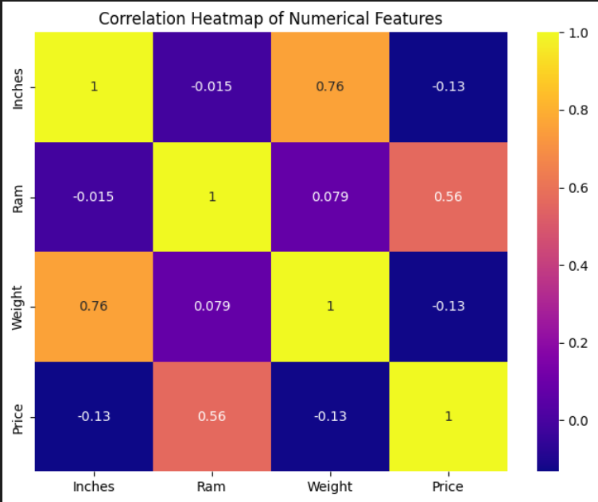
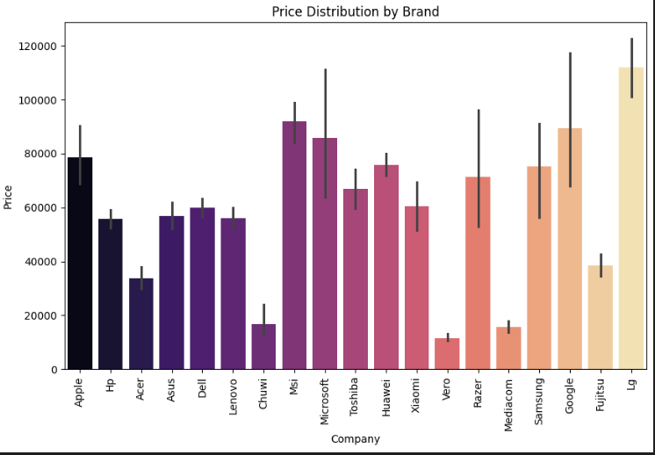
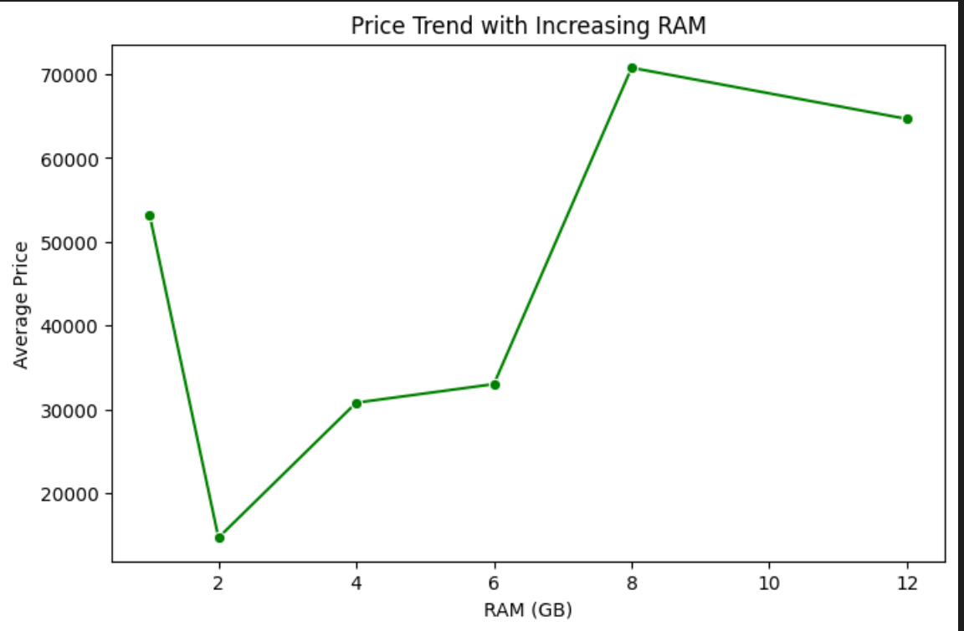
Data Visualization

Slide 9
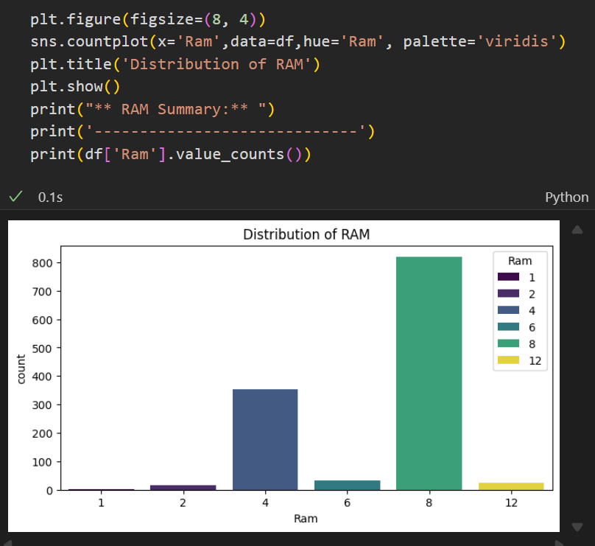
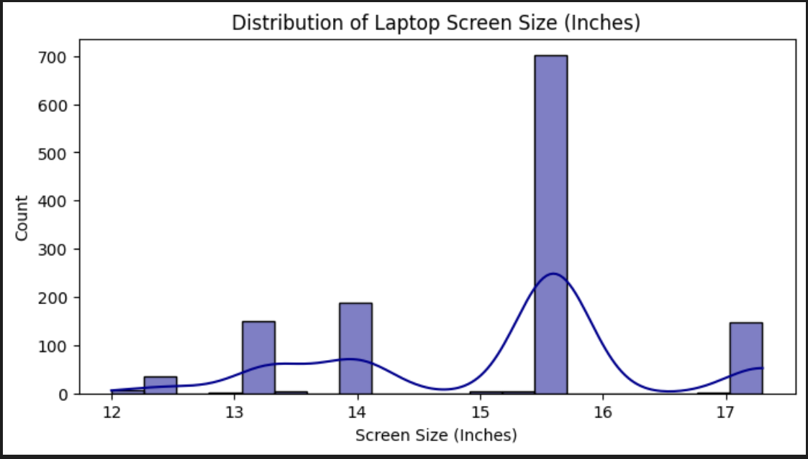
Univariate Analysis

Slide 10
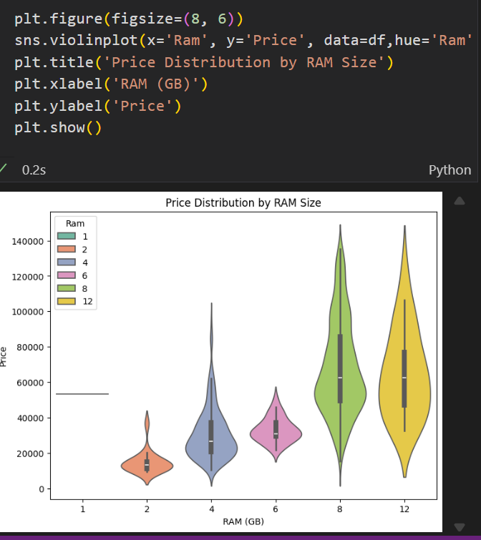
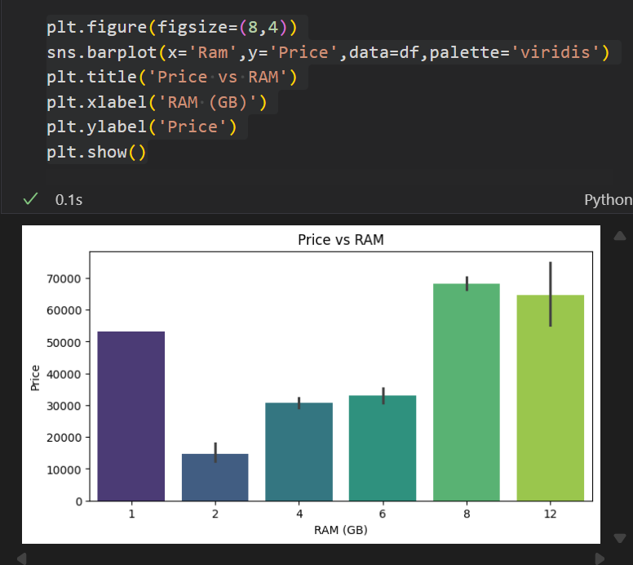
Bivariate Analysis

Slide 11
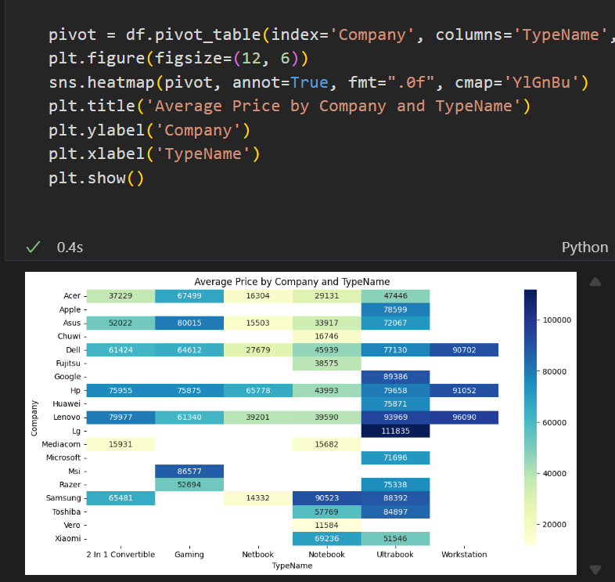
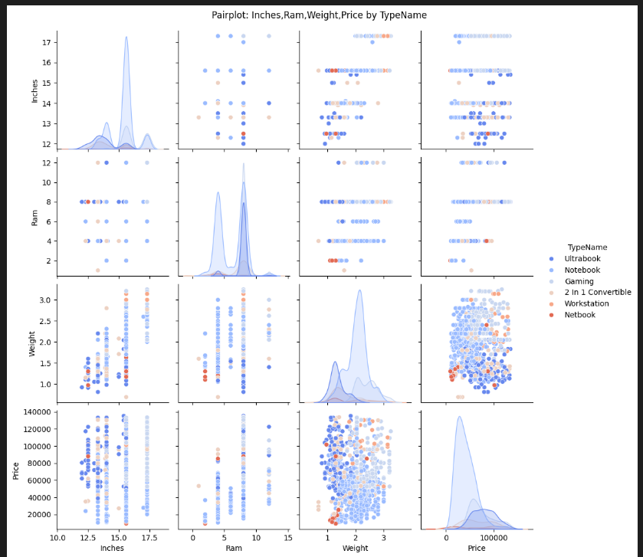
Multivariate Analysis

Slide 12
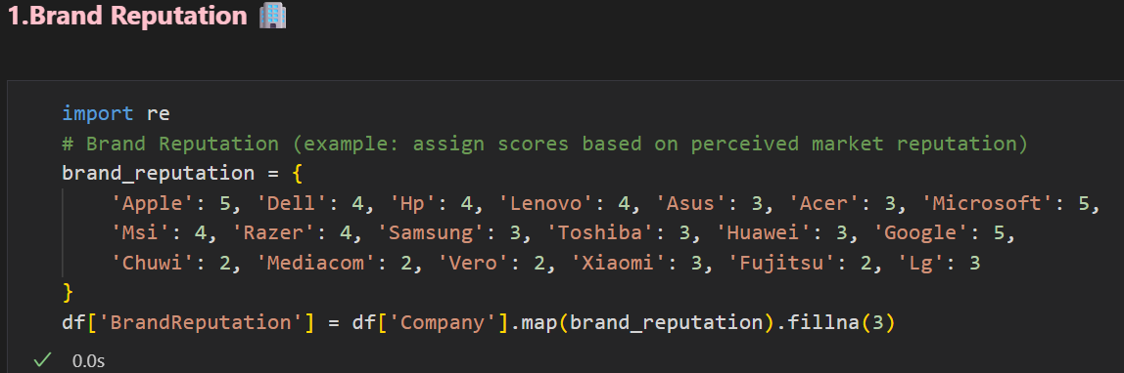
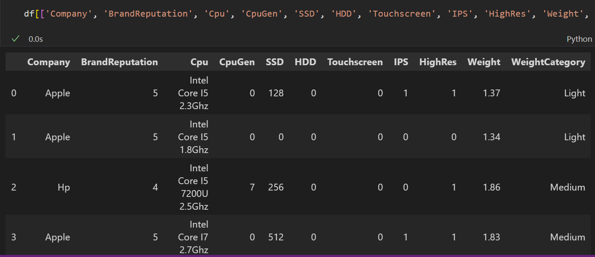
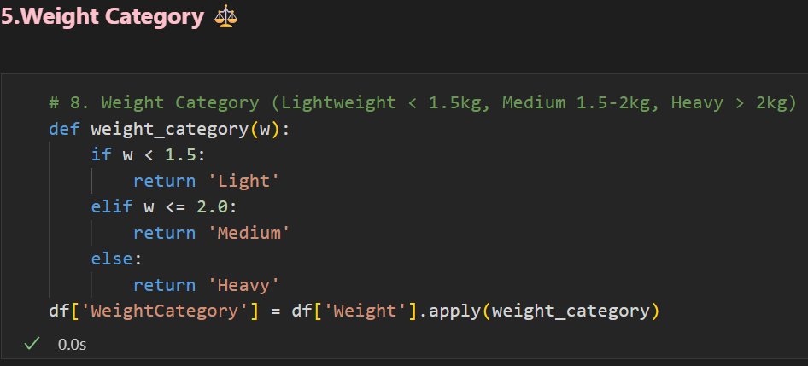
Feature Engineering
New Features :-

Slide 13
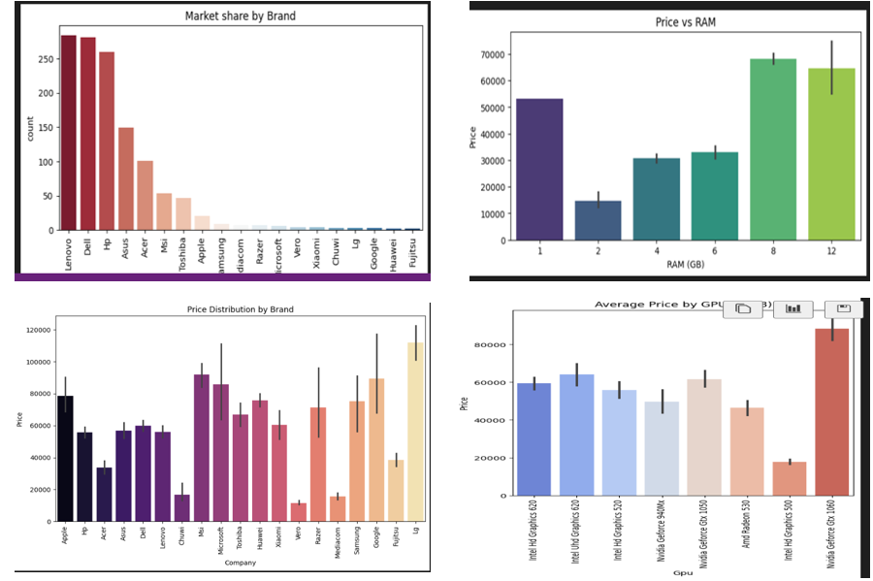
🔑 Key Insights
Premium brands (Apple, Microsoft, Razer), higher RAM/SSD, newer CPUs, and dedicated GPUs drive laptop prices.
Advanced display features (Touchscreen, IPS, High-Resolution) and lightweight designs add significant value.
Clear market segmentation exists: Premium, Balanced, and Budget laptops.

Slide 14
📌 Recommendations
Focus on lightweight, premium-display, and gaming models while marketing CPU, RAM/SSD, and brand reliability.
Implement clear pricing tiers and explore 2-in-1 hybrids and eco-friendly designs for growth.

Slide 15
ANY QUESTIONSS !!!
THANK YOU !!!

